Slide 1

University Institute of Liberal Arts and Humanities
Course Name- Communication Skills
Course Code- 23PCH-105
CIRCULAR
DISCOVER . LEARN . EMPOWER

Slide 2
COURSE OBJECTIVES
The Course aims to:
1 | Augment students overall communication and interpersonal skills by making them realize the importance of good oral and written English Language in professional life.
2 | Enrich their reading capability with special emphasis on expanding vocabulary and grammatical formations.
3 | Build exceptional speaking, reading and writing skills by correcting grammatical errors and pronunciation through practice.
4 | Enhances soft skills by fostering self awareness, confidence and a positive attitude in students’ ability to communicate effectively in English.

Slide 3

COURSE OUTCOMES
On completion, the students are expected to:
CO Number | Title | Level
CO1 | Apply appropriate Listening, Speaking, Reading and Writing Skills (LSRW Skills) with correct non-verbal cues to attain expertise in soft skills. | Apply
CO2 | Apply correct contextual and comprehensible written text in the form of paragraph writing, short compositions business correspondence, using logical support and argument in a wide range of communication situations. | Apply
CO3 | Demonstrate linguistic competence while speaking and during presentations through accuracy in grammatical usage, vocabulary, pronunciation and intonation. | Apply
CO4 | Evaluate information as critical readers, speakers and writers applying ethics in communication and being sensitive in cross cultural communication. | Evaluate
CO5 | Create original, digital content for websites, blogs, vlogs and personal social media profiles etc. | Create
https://lh3.googleusercontent.com

Slide 4

Circulars
Circulars convey the information about some routine process or circulate some information to a large number of people.
Such information is usually of general nature and not confidential.
www.shutterstock.com

Slide 5
Purpose of Writing Circulars
Circulars can be used for following purposes:
To emphasize certain aspects of office conduct.
To give information about new procedures & policies.
To intimate changes in the working hours of the office, canteen, library etc.
To invite applications from the employees for the promotion tests etc.
To inform the employees about changes in medical rules, L.I.C. rules etc.

Slide 6
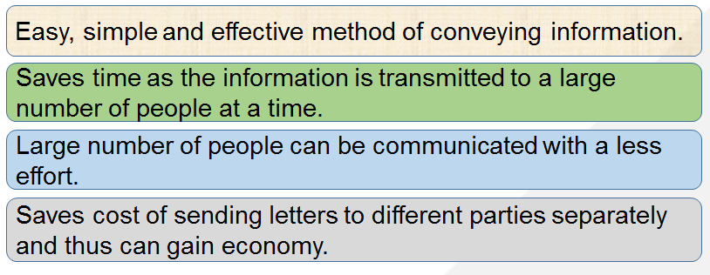
Importance of Circulars

Slide 7
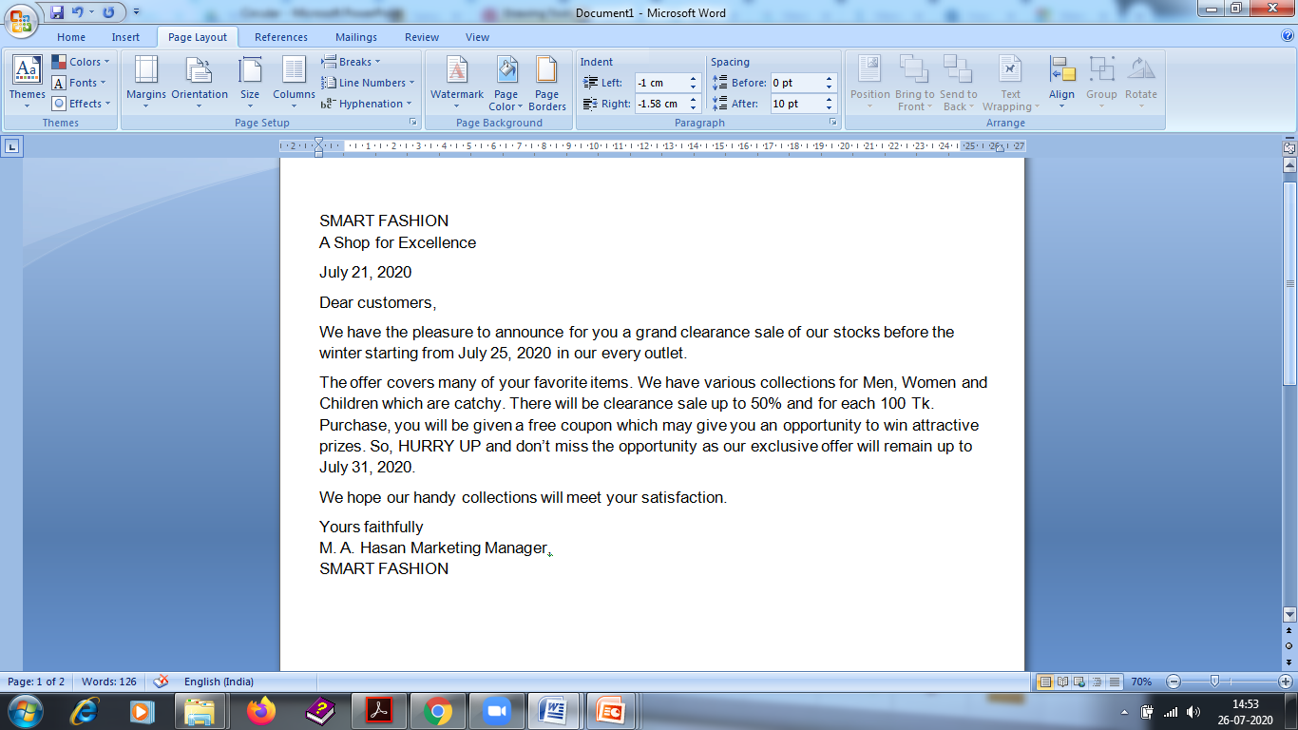
Sample

Slide 8
Practice
Write a circular letter announcing a clearance sale in the show room.
OR
Write a circular announcing the commencement of odd semester in the university.

Slide 9
Applications
The instructions about the work related information by the organization helps to work smoothly.
Correct grammar , punctuation and spellings are the keys in written communication , hence these can be improved with the practice.
Technical words used in writing skills improve vocabulary .

Slide 10
Assessment Pattern
Students are assessed on the basis of the following parameters:
Hourly Tests - 2
Assignments
Surprise Test
Quiz
Student Engagement
End Semester Exam

Slide 11
References
https://www.pearson.com/us/
https://www.atpeducation.com/home
https://www.learnpick.in/prime/documents/notes/details/4727/memos-circulars-and-notice
Practical English Usage fourth edition by Michael Swan(Online book at Flipkart).

Slide 12
THANK YOU
For queries
Email: communicationskills.uilah@gmail.com

